Slide 1
Data Structures and Algorithms -3 (25CS2103E)
Alumni Connect
SAI SHASHANK – 2520030433
ARUN TEJ – 2520030472
YUVAN SHIVAMANI - 2520030310
Under the Esteemed Guidance of
Dr. V. Sireesha
Professor, Department of CSE

Slide 2
Contents
Abstract
Introduction
Literature survey
Problem Statement and Objectives
Hardware and Software requirements
Results
Conclusion
Future Scope

Slide 3
Abstract
Alumni Connect is a centralized web-based platform designed to strengthen and modernize communication, collaboration, and professional networking among students, alumni, and educational institutions. In many colleges and universities, alumni information is maintained through scattered databases, spreadsheets, social media groups, or outdated records. These traditional approaches make it difficult to maintain accurate alumni information and prevent students from easily identifying suitable alumni for mentorship, career guidance, placement assistance, internships, and professional networking. Alumni Connect addresses these challenges by providing a single, organized, and user-friendly platform for managing and utilizing alumni relationships effectively.
The proposed system allows students and alumni to create authenticated profiles containing important information such as educational qualifications, technical and professional skills, areas of interest, work experience, career preferences, achievements, and contact information. Students can search and discover alumni based on specific skills, interests, academic background, industry, or professional expertise. This skill- and interest-based discovery mechanism helps students connect with relevant alumni who can provide personalized career advice, mentorship, industry insights, interview preparation, and placement guidance.
The platform also provides a structured mentorship system, through which students can send mentorship requests to suitable alumni and alumni can accept and guide students according to their expertise and availability. Alumni can contribute by sharing their professional experiences, career paths, learning resources, job opportunities, internship opportunities, and industry knowledge. This creates a collaborative environment where knowledge and experience can be transferred from alumni to the current generation of students.
Educational institutions can act as administrators of the platform by maintaining updated alumni records, verifying user accounts, managing profiles, organizing alumni activities, and publishing important announcements. Institutions can also share placement opportunities, internships, workshops, reunions, seminars, networking events, and other career-related programs through a centralized notification system. This reduces dependence on fragmented communication channels and improves engagement between the institution and its alumni community

Slide 4
Introduction
ALUMNI CONNECT
Bridging Students, Alumni & Institutions
A centralized platform for student–alumni interaction and professional networking.
Provides a single system to manage and maintain alumni information.
* Helps students discover suitable alumni based on skills, interests, education, and professional expertise.
* Enables mentorship, career guidance, placement assistance, internships, and networking.
* Allows institutions to manage alumni records and share events, opportunities, workshops, and announcements.
* Creates a collaborative environment for knowledge and experience sharing.

Slide 5
Literature Survey
Existing alumni systems mainly manage alumni records and communication.
Traditional methods use spreadsheets, databases, emails, and social media.
Efficient DSA techniques can improve data organization and searching.
Alumni Connect uses:
  Arrays & Linked Lists
  Hashing
  Searching & Sorting
  String Matching
  Graphs
  Dynamic Programming
These techniques help students find suitable alumni for mentorship and networking.

Slide 6
Problem Statement and Objectives
Problem Statement
Traditional alumni management methods use scattered databases, spreadsheets, outdated records, and social media groups. These methods make it difficult to maintain accurate alumni information and allow students to quickly identify suitable alumni for mentorship, career guidance, internships, placements, and professional networking.
Therefore, there is a need for a centralized system that can efficiently manage alumni information and provide fast searching, matching, and communication using Data Structures and Algorithms.
Objectives
To maintain alumni information in an organized manner.
To provide authenticated student and alumni profiles.
To enable fast searching of alumni.
To search alumni based on skills, interests, industry, and expertise.
To provide a structured mentorship request system.
To facilitate career guidance and professional networking.
To share job and internship opportunities.
To allow institutions to manage and verify alumni records.
To apply DSA concepts to solve a real-world networking problem.

Slide 7
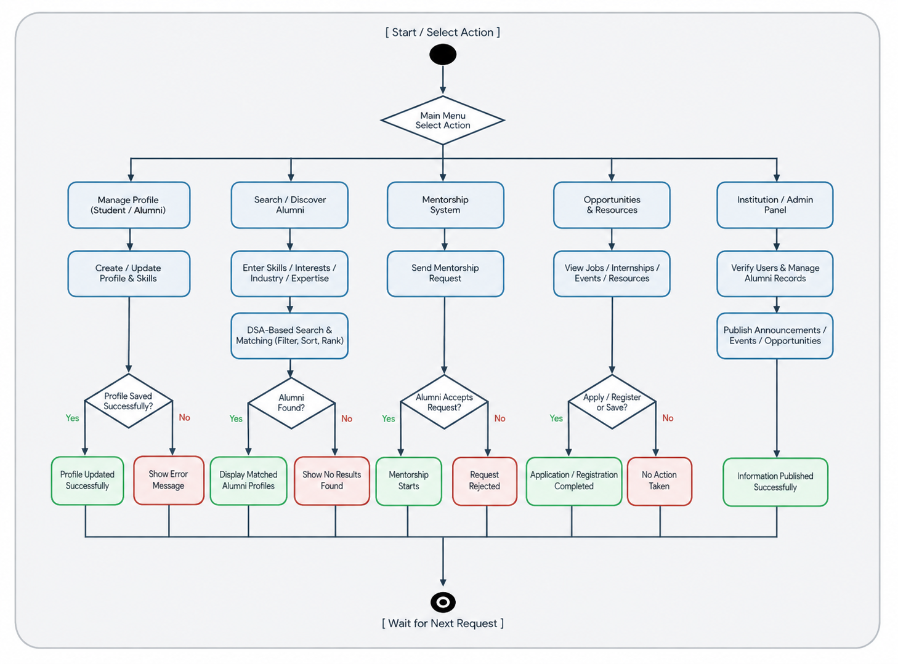
Flow Chart

Slide 8
Results
The Alumni Connect system provides an organized and efficient platform for managing interactions between students, alumni, and educational institutions.
The system enables users to create and manage profiles containing educational qualifications, skills, interests, professional experience, and career information.
The alumni discovery feature allows students to search for suitable alumni using different parameters such as skills, industry, interests, and professional expertise.
The mentorship feature provides a structured method for students to send requests to relevant alumni and receive career guidance.
The system also supports sharing of job opportunities, internships, events, workshops, and other announcements.
By applying suitable Data Structures and Algorithms, the system improves the organization, searching, filtering, and retrieval of alumni information.
Overall, the proposed system provides a centralized, user-friendly, and efficient solution for student–alumni networking.

Slide 9
Hardware and Software requirements
Hardware Requirements
Processor: Intel Core i3 or above
RAM: Minimum 4 GB
Storage: Minimum 10 GB free space
Keyboard and Mouse
Monitor / Laptop
Internet Connection
Software Requirements
Operating System: Windows 10/11, Linux, or macOS
Programming Language: Java
Frontend: HTML, CSS, JavaScript
IDE: Visual Studio Code
JDK: JDK 8 or above
Database: MySQL / suitable database
Version Control: Git / GitHub

Slide 10
Conclusion
The Alumni Connect project demonstrates how Data Structures and Algorithms can be applied to solve a real-world problem involving alumni management and professional networking.
Instead of maintaining alumni information through scattered databases, spreadsheets, or social media groups, the proposed system provides a centralized platform for managing student and alumni profiles.
Features such as efficient searching, sorting, profile matching, mentorship requests, and networking make it easier for students to connect with relevant alumni.
The use of DSA concepts improves data organization, searching efficiency, and information retrieval.
Overall, Alumni Connect provides a structured, reliable, and user-friendly platform that strengthens communication between students, alumni, and educational institutions.

Slide 11
Future Scope
Develop a complete mobile application for Android and iOS.
Add AI-based alumni and mentor recommendations.
Implement advanced skill-based matching.
Add real-time chat between students and alumni.
Integrate video meeting facilities for mentorship.
Add email and push notifications.
Provide advanced alumni analytics and dashboards.
Integrate LinkedIn or other professional profiles.
Add recommendation systems for jobs and internships.
Implement cloud-based storage for scalability.
Add an AI chatbot for career guidance.
Improve matching algorithms using student career preferences.
Add alumni donation and fundraising management.
Support large-scale networking across multiple institutions.

Slide 12
Thank you

